Slide 1


TRADE AND BUSINESS
DATA VISUALIZATION LAB
Course: CS595
Course Instructor:
Dr. Ashish Anand
Neelmani
224161019

Slide 2
DESCRIPTION OF DATASET
Files given:
startup_funding.csv : This dataset provides valuable insights into the funding trends for startups in various industries and cities. It can be used for analyzing the funding patterns of startups, identifying the most active investors, and understanding the different types of funding startups receive.
Credit_Card_uses.csv : This dataset can be used to analyze credit card usage patterns in different cities, track expenditure types and amounts, and identify spending trends based on card type and gender. It may be useful for credit card companies, financial analysts, and marketing professionals who want to gain insights into consumer spending behavior.
Real Estate data of 3 city: Bangalore, Delhi, Pune: This dataset can be used to analyze the real estate market in a city, identify popular areas for residential properties, track property availability, size and amenities, and understand pricing trends based on location and property type. It may be useful for real estate agents, property developers, and investors who want to gain insights into the real estate market in the city.
Startups.csv: This dataset provides valuable insights into the funding trends for startups from the year of their inception. It can be used for analyzing the growth and potential of startups.
Overall, these datasets provide valuable insights into different industries and markets. By combining the information from all three files, one can gain a comprehensive understanding of the startup ecosystem, consumer spending behavior, and real estate market in a city, which can help make informed business decisions.
Files taken on own

Slide 3
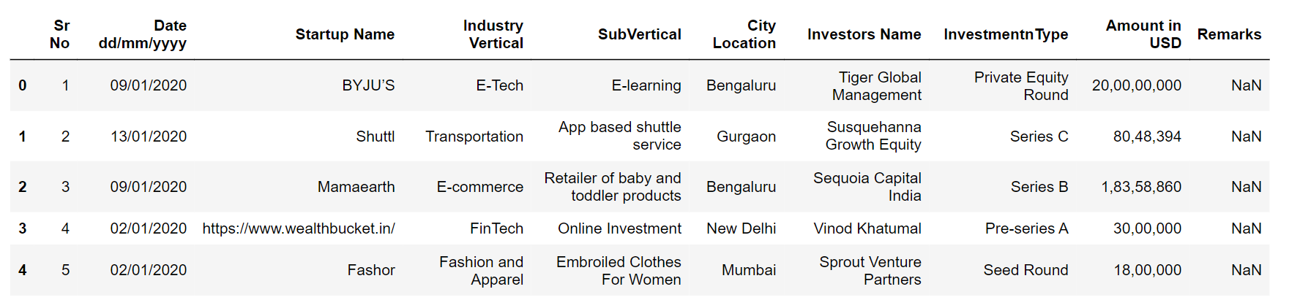
startup_funding.csv
This dataset provides valuable insights into the funding trends for startups in various industries and cities. It can be used for analyzing the funding patterns of startups, identifying the most active investors, and understanding the different types of funding startups receive.
DATA CLEANING
Invalid dates
Invalid amounts
Numbers in “Amount in USD” column
Inappropriate City Location

Slide 4
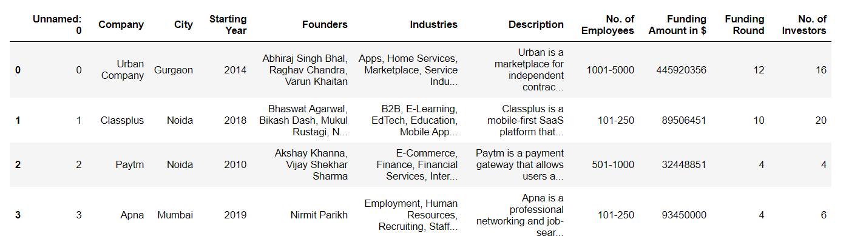
Startups.csv
DATA CLEANING
Number of Employees

Slide 5
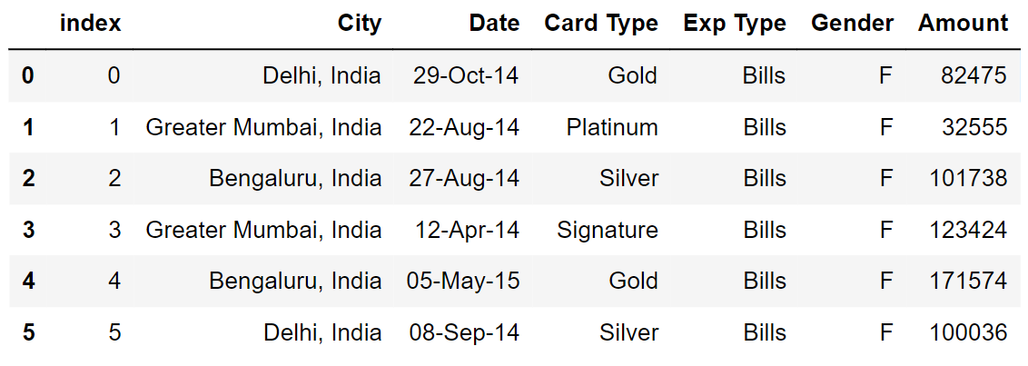
Credit_Card_uses.csv
This dataset can be used to analyze credit card usage patterns in different cities, track expenditure types and amounts, and identify spending trends based on card type and gender. It may be useful for credit card companies, financial analysts, and marketing professionals who want to gain insights into consumer spending behavior.
DATA CLEANING
Invalid dates
Modifying city names

Slide 6
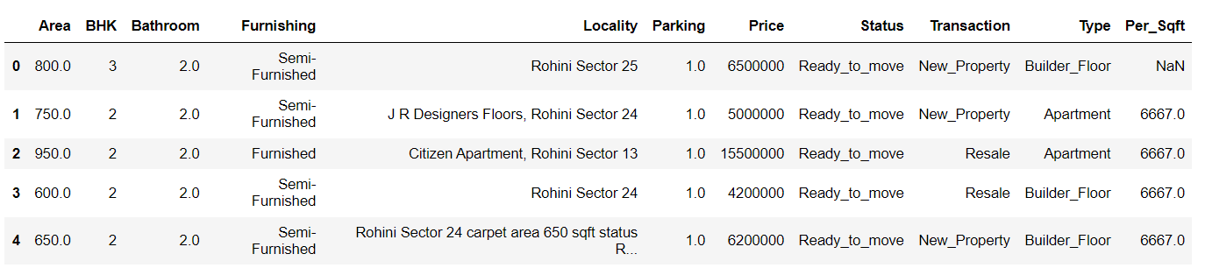
Delhi.csv
With these data sets, we can plot various meaningful data visualizations that can offer insights into the real estate market in Delhi city.
DATA CLEANING
Per_Sqft
Locality

Slide 7
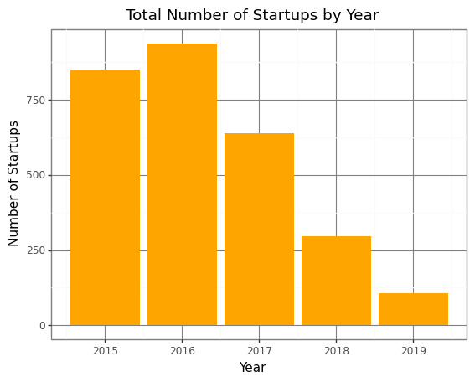
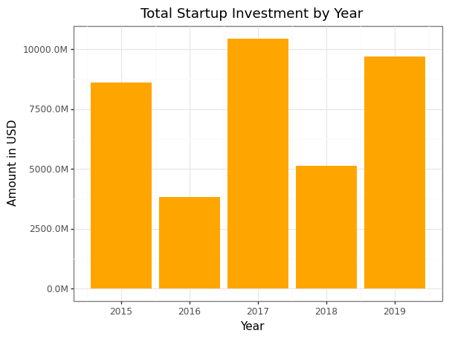
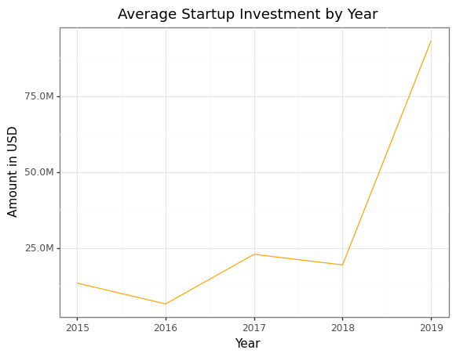
PLOTS: Startups at a Glance
Startup Ecosystem:
we can see that there are
fluctuations in the number of
startups and investment from
year to year
Observation: Based on the plot diagram, it appears that the average investment in startups has been steadily increasing over the years from 2015 to 2019. There is a slight dip in 2016(due to recession) and 2018, but overall the trend is upwards. It's also worth noting that the amount of investment seems to be increasing at a faster rate in later years, with a sharper incline towards the end of the time period in 2018 and 2019. The average investment in 2019 is approximately 7 times higher than in 2015.

Slide 8
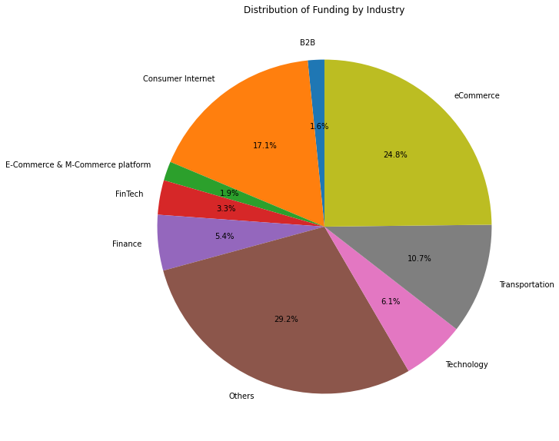
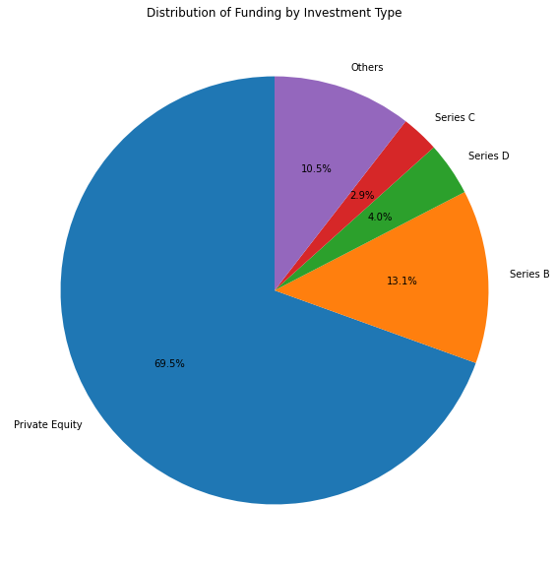
PLOTS: Distribution of Funding by Industry And Investment Type
Observation:
preference among investors for certain types of industries, possibly due to factors such as the potential for growth and profitability
a small number of industries receiving a large proportion of the funding.

Slide 9
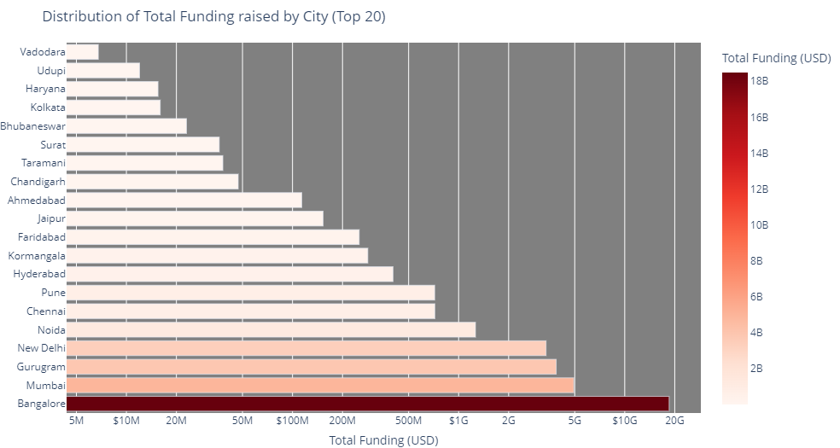
PLOT: Total Funding raised by City
DESCRIPTION
This can highlight the cities with a higher concentration of successful startups or those attracting the most investments.
This plot suggests that investors are more likely to fund startups based in larger, more established cities with a more developed startup ecosystem
This can highlight the cities with a higher concentration of successful startups or those attracting the most investments.

Slide 10
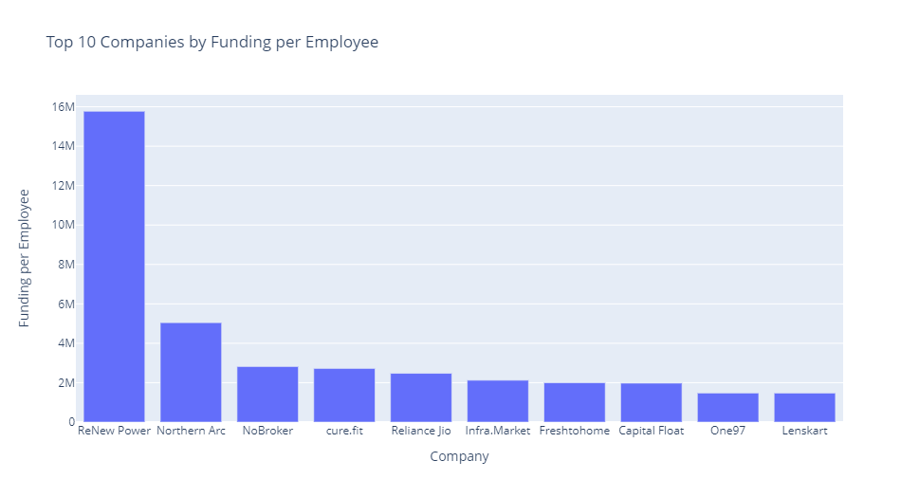
PLOT: Startup Potential
This can reveal the correlation between the size of a startup and its ability to raise funds, indicating possible efficiency or popularity aspects.

Slide 11
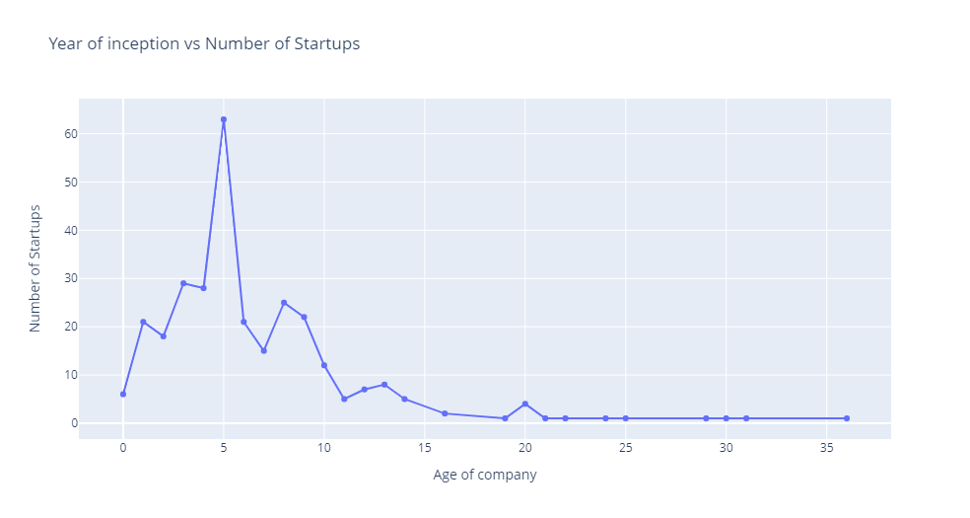
PLOT: Funding by Company Age
DESCRIPTION
This metric involves plotting the total funding raised by companies based on their age (i.e. number of years since inception). This can help identify if there is a correlation between the age of a company and the amount of funding they receive.
OBSERVATION:
From the plot we can see that the investor rely more in the company of age between 2-10 years for investment.

Slide 12
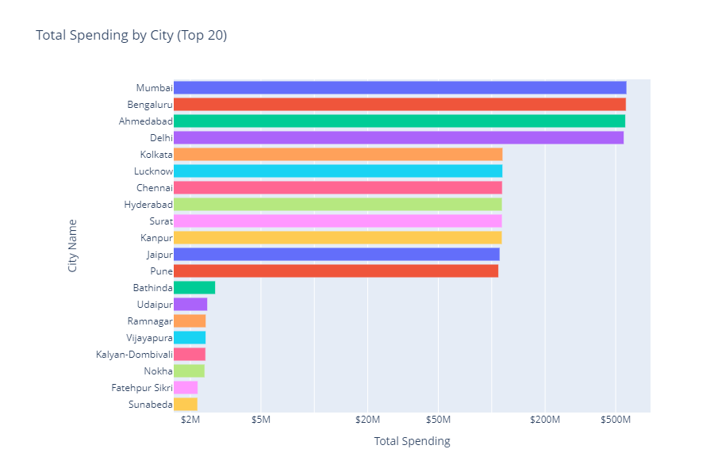
PLOTS: Spending
This plot suggests that cities with larger populations, higher economic activity, and greater purchasing power tend to have higher credit card spending.
distribution of credit card spending across different cities in India and can be useful for businesses and investors looking to better understand the Indian consumer market.

Slide 13
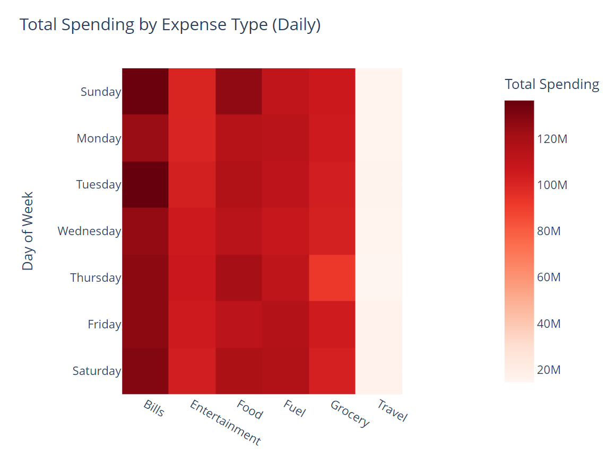
PLOT: Spending by Expense Type on Weekly Basis
DESCRIPTION:
The heatmap shows the total spending by expense type for each day of the week. The expense types are listed on the x-axis and the days of the week are listed on the y-axis.

Slide 14
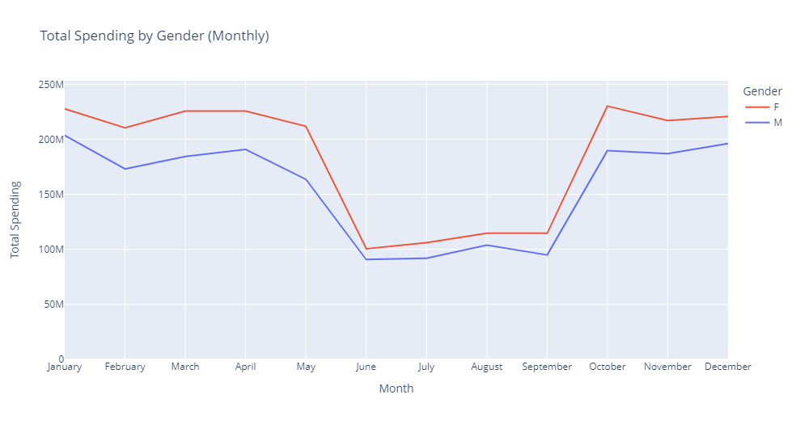
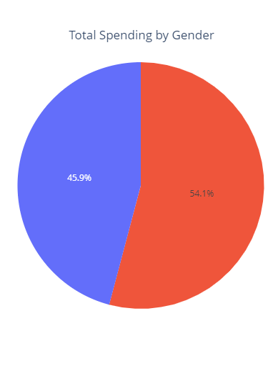
PLOT: Monthly Trends of Spending by Gender
Plot the monthly or yearly total or average expenditure trends for the entire dataset to identify seasonal patterns or general trends in credit card usage over time.

Slide 15
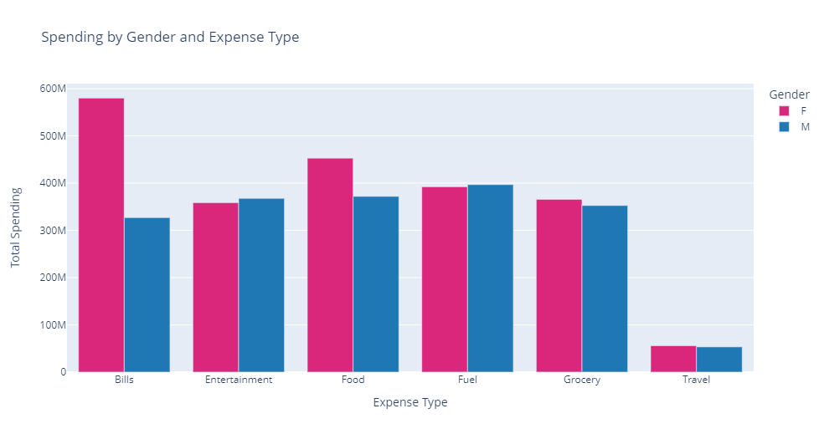
PLOT: Expenditure Type by Gender
DESCRIPTION
Analyze the expenditure types by gender to understand if specific categories are more popular among a particular gender and identify potential opportunities for targeted marketing.

Slide 16
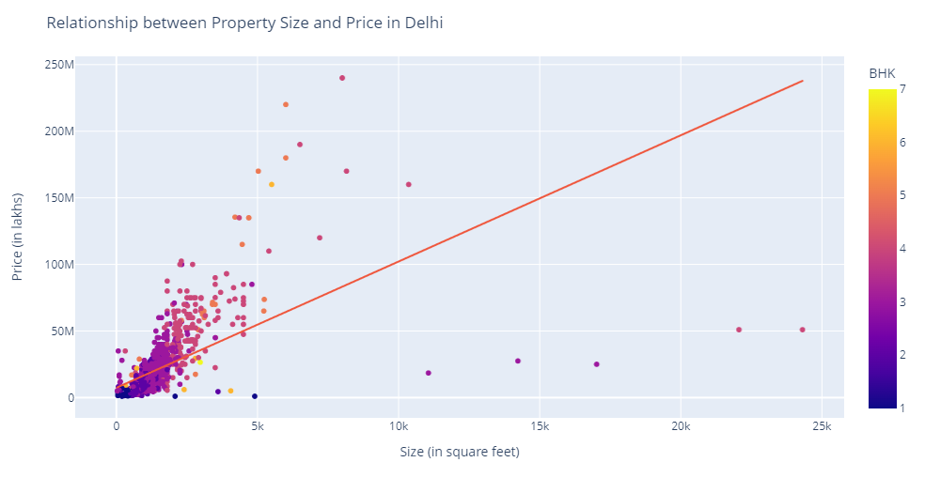
PLOT: Relationship between Property Size and Price
REAL ESTATE: Delhi
DESCRIBTION:
The plot shows the relationship between property size (in square feet) and price in Delhi. A linear regression line is added to the plot, and the color="BHK" argument colors the data points by the number of bedrooms (BHK) in the property.
OBSERVATION:
The plot can help to visualize the overall trend between size and price, as well as any variation in this trend based on the number of bedrooms in the property.

Slide 17
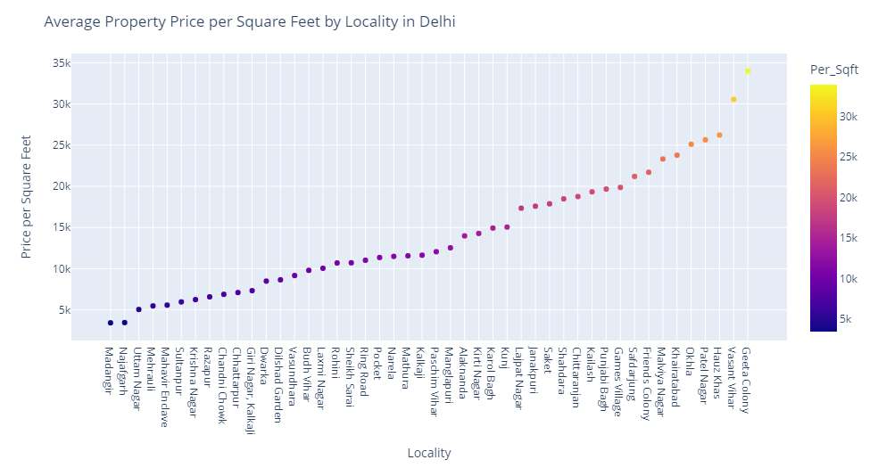
PLOT: Property prices by location
DESCRIPTION
This plot is used to identify the locations with the highest and lowest property prices, thus providing insights into the most and least expensive.

Slide 18
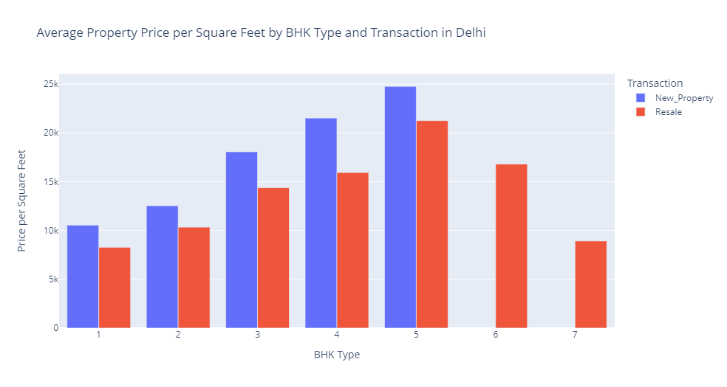
PLOT: Average Property Price by BHK and Transaction
OBSERATION:
From the plot, we can observe that in general, as the number of BHKs increases, the average price per square foot also increases. Additionally, we can see that the average price per square foot for new construction properties is generally higher than for resale properties, across all BHK types.

Slide 19
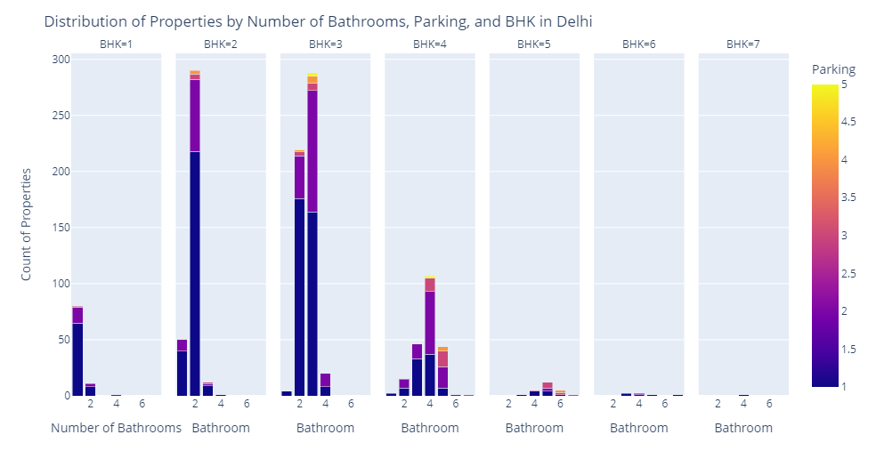
PLOT: Number of properties by BHK
DESCRIPTION
The plot provides an informative view of the distribution of properties in Delhi based on their size, amenities, and parking spaces.

Slide 20
THANK YOU

